Slide 1

Modern Microservices
Continuous Integration
Daniel Williams (dwilliams@kenzan.com)
2019-01-17
https://github.com/kenzanlabs/modernmicroservices

Slide 2
About
Kenzan
We are a software engineering and digital consulting firm that has been helping clients Make Next Possible for over a decade:
Core offerings Application Development, Platform as a service, cloud virtualization, platform engineering, consulting services and business transformation.
Primary Clients Multi billion dollar companies and media/content providers such as Thompson Reuters, Charter & Cablevision Locations Providence (RI), New York (NY), Denver (CO), Los Angeles (CA), and a London presence
Founded in 2004.
Full Service Consulting Firm Architecture, front and back end development, business analysis and DevTest.
Cloud Virtualization Experts And Enablers AWS, Netflix stack, enterprise architecture and beyond.
DevOps Leadership Platform builds, continuous delivery and scalable resourcing.
Veterans of the Media Industry Migrations, enterprise wide solutions, digital experts and thought leaders.
Employee focused Collaboration, communication and culture are key.

Slide 3


Agenda
Multiple Part Series Focusing on:
Platform & Infrastructure
Continuous Delivery
Continuous Integration
Application

Slide 4
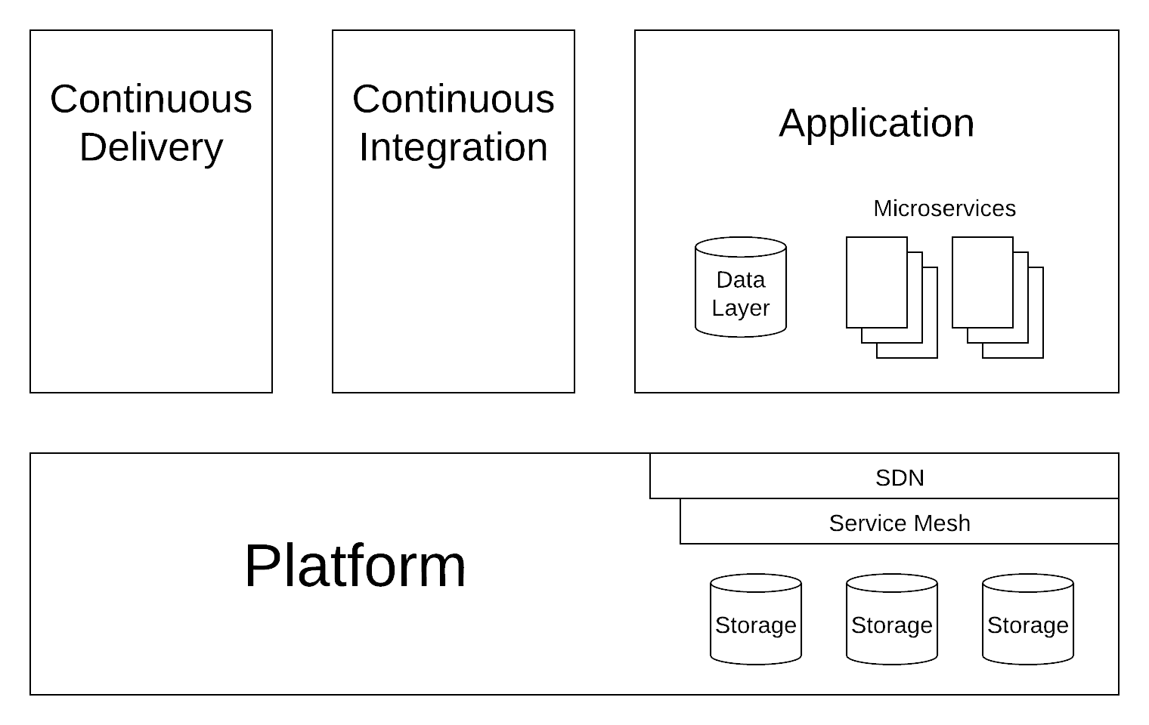
The Whole Picture

Slide 5
What is Continuous Integration?
Continuous Integration (CI) is:
Automated building and testing of applications.
Reducing time to feedback to developers.
Catching possible quality issues before release.

Slide 6
Build Service
Continuous Integration happens on the Build Service.
Really is a scheduling service with special triggers to watch source code repositories.
Examples:
Jenkins/Hudson
TravisCI
CircleCI

Slide 7
Version Control (Source)
Make sure everything is in version control. EVERYTHING!
This is the starting point of the Continuous Integration process.
Store the CI build pipeline configuration in version control too.
Examples:
Github (git)
Gitlab (git)
Bitbucket (git)

Slide 8
Linter
Linters perform syntax checks:
Validates syntax (will it compile/run?)
Enforces coding rules and standards
Checks for code smells (like unused imports, bad scoping)
Checks for in-line documentation
Examples:
eslint (NodeJS)
pylint or flake8 (Python)
FxCop or ReSharper (C#)

Slide 9
Test Framework & Runner
Testing is an foundational component of Continuous Integration.
Always use a test framework & runner.
Tests should be as automated as possible, without being a burden.
The test framework allows for reusing mock, fixtures, and requirements for tests, making tests easier to write.
The test runner should perform code coverage analysis.
Examples: pytest & coverage (Python), Jasmine & Istanbul (NodeJS/JavaScript), Jest & Jest (NodeJS/JavaScript)

Slide 10
Builder/Compiler
Makes all the things…
Should output useful error messages.
Should work quickly. If this step takes a long time, you likely need modules/libraries.
Examples:
gcc/g++/clang (C/C++)
javac (Java)
TypeScript (NodeJS)

Slide 11
Packager
Makes all the things…useful, deployable, etc.
Bundles build artifacts in to a deployable artifacts:
.apk for Debian
.egg or .whl for Python
minified and gzipped .js for NodeJS/JavaScript
Examples:
browserfy, webpack (NodeJS)
setuptools (Python)

Slide 12
Static Analysis
Analyse code and binaries checking for known vulnerabilities and bugs.
Much of the code analysis aspects are handled in the linter. This step is more important for compiled code bases.
Examples:
nDepend (C#)
SonarQube/Scanner (Many)
Fortify (Many)

Slide 13
Artifact Repository
The artifacts (outputs) of testing, building, and packaging should be version controlled.
This allows for build and test once, then deploy into different environments (e.g. deploy what’s tested, not a rebuild).
Examples:
Github Releases
Artifactory
S3-like Object Stores
Docker Hub

Slide 14
Techniques
Make libraries and/or modules, store them in the artifact repository, use them in the application.
Small, fast builds for developer branches. Larger, more coverage builds for integration branches.
Pin to versions of library and module artifacts.

Slide 15
Code Walkthrough
https://github.com/kenzanlabs/modernmicroservices
https://github.com/dwilliams-kenzan/cicd-example-app

Slide 16




Want to learn more?
Follow us!
@kenzanmedia
www.linkedin.com/company/kenzan-media
techblog.kenzan.com
www.facebook.com/kenzanmedia/

